Slide 1
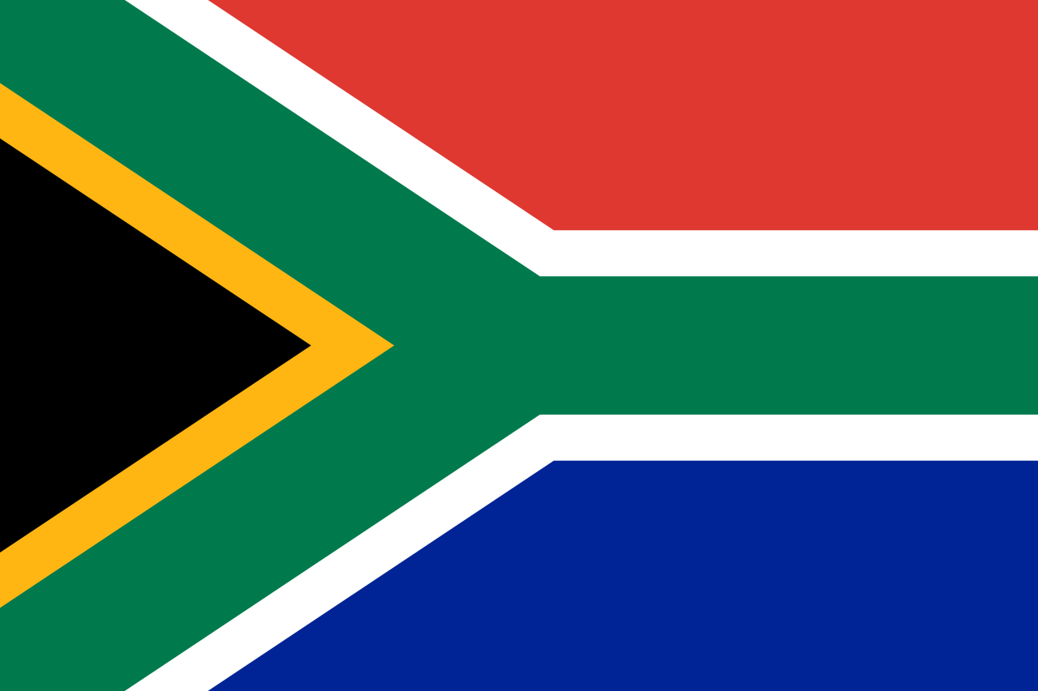
South Africa
Truth and reconciliation Commission

Slide 2
What is the TRC?
Truth telling and conditional amnesty program designed to:
Reconstruct society and to abolish the horrendous inequalities which were produced by the apartheid system
Established by the National Unity and Reconciliation Act in 1994
Timeline: Dec. 2005 – 2002*
Notes:
Gibson
“The creation of the Truth and Reconciliation Commission, with the power to grant amnesty, was the price the liberation forces had to pay in order to secure a peaceful transition to a majority rule” (541)
Gibson 2
included broad objectives such as “creating a collective memory for the society, establishing and nurturing a culture of human rights in South Africa, transforming the society, and enhancing reconciliation, in addition to granting amnesty to those admitting to involvement in gross human rights violations” (412-413)
Asmal
“although the ANC rejected all ideas of a blanket amnesty, part of the rationale for setting up the Truth and Reconciliation Commission (TRC) was the need to prevent further alienation of right-wing elements” (11)
“the crucial requirement of the South African transition (was) the need to reconstruct society and to abolish the horrendous inequalities which were produced by the apartheid system” (11)
Llewellyn
Despite election of government of “national unity” in 1994, needed more to “make unity a reality”. “The transition to a past marred by human rights abuses to one based on the principles of democracy and respect for human rights could not be had simply by a transition in government” (366)
December 1995 – 2002 (originally set to end in 1998, but was extended) (USIP)

Slide 3
Background: The Apartheid System
“System of legally enforced racial segregation”
South African blacks:
Denied civil and political rights;
Subjected to inferior social services and living standards;
Pushed to the margins of society
Resistance movements and freedom of expression strongly (and violently) repressed by the National Party
Timeline: 1948 – 1990*
Notes:
USIP
“Apartheid was a system of legally enforced racial segregation in South Africa between 1948 and 1990. The National Party that controlled the government formalized and expanded segregationist policies that had existed less formally under colonial rule. Institutionalized racism stripped South African blacks of their civil and political rights and instituted segregated education, health care, and all other public services, only providing inferior standards for blacks and other non-Afrikaans. Internal resistance was met with police brutality, administrative detention, torture, and limitations on freedom of expression. Opposition groups, such as the African National Congress (ANC) and other movements, were banned and were violently repressed.
After a series of international sanctions – and the end of the Cold War – a mostly peaceful transition from the Apartheid system started with a series of negotiations between the government party and the ANC between 1990 and 1993. Democratic elections were held in 1994, and an interim constitution was passed. The Truth and Reconciliation Commission was set up by the newly elected parliament and was endorsed by opposition leader Nelson Mandela and other prominent South African figures.”
Asmal
1948 – National Party election win “inaugurated a period of consolidation and caution as apartheid’s whites-only electoral majority was stabilized” (9)
‘50s – civic agitation against apartheid -> led to banning of liberation movements (ushered in period of underground activity, starting 1960)
1976 – student uprising in Soweto
1980s – growing agitation
United Democratic Movement – aim to make South Africa ‘ungovernable’
Growing economic sanctions from abroad – impact on business leaders
1989 – F. W. de Klerk assumed presidency, recognized Botha’s aggressive use of force not working; began move towards transition (still with minimal black control of government in mind)
1990s
Release of Mandela
Increase in National Party’s use of force through hit squads; innocent civilians killed; trying to frame conflict as black-against-black violence
Bloodiest period of apartheid between 1990-94
1994 – ANC election victory (63% majority vote)
Llewellyn
“The system of apartheid introduced by the National Party (NP) government in 1948 was maintained and perpetuated by acts of manipulation, coercion, and violence. The result was a country premised on lies, secrecy, and the abuse of basic human rights. South Africa endured decades of war waged for liberation from this racial oppression. Apartheid was an all-pervasive system seemingly secure and unstoppable” (365)

Slide 4
Insurgency Description*
African National Congress (ANC):
Recognized as the representative party of apartheid’s victims
Began as a peaceful movement that acted through protests
Strategies and composition shifted over time
Forced underground in 1960 (in response to Sharpeville Masacre)
Umkhonto We Sizwe (Spear of the Nation / MK) – ANC’s militant arm
National Party:
Perpetrators of apartheid
Political leaders throughout the entire apartheid era (‘48-’90)
Notes:
MSU
Early African political movements, most notably the African National Congress (founded in 1912 and known also as the ANC or “Congress”), emphasized a strategy of peaceful constitutional protest to try to incorporate Africans more fully into colonial society. This strategy reflected a heavy influence by liberal democratic and Christian philosophies. Pre-1949 ANC politics were moderate, seeking greater influence for Africans within the existing government.
The composition of the ANC changed over time. Early ANC leaders were largely drawn from the educated, Christian, black elite—people such as John Dube and Pixley Seme (both educated in the U.S.). Most were relatively well-off economically. Others, such as the largely self-educated Solomon Plaatje, came from far less privileged backgrounds. Significantly, the colonial basis of South African society meant that all blacks were oppressed, hence the ANC’s appeal to a wide range of social classes. By the 1950s, with growing industrialization and the urbanization of Africans, the ANC began attracting a large number of black workers.
The apartheid government repeatedly met peaceful protests with violent repression. Bannings, detentions, and harassment of liberation movement leaders and activists became commonplace. The most brutal example of repression from this period was the Sharpeville Massacre of March 21, 1960, when policemen killed at least sixty-nine defenseless people—many of whom were shot in the back—during a peaceful PAC demonstration against pass laws. In the immediate aftermath of Sharpeville, the apartheid government declared a State of Emergency and banned the ANC and PAC.
Forced underground, the ANC and its allies adopted new tactics. Most significantly, the movements launched a campaign of armed struggle. The ANC had always advocated non-violent methods, so debates over the use of violence were acrimonious
In December 1961, Mandela became the commander-in-chief of the ANC’s new armed wing: Umkhonto We Sizwe (“Spear of the Nation,” or MK).

Slide 5
Impetus for Peace & Reintegration
Pathway to Peace: Early 1990s
SA suffering economically (increased international sanctions/pressure against the regime)
1989: F.W. de Klerk replaces Botha as NP President
End of the Cold War
1990: Mandela released
1991-1992: CODESA
1994: Democratic Elections
Pathway to Amnesty: TRC
For peaceful democratic transition, NP required amnesty
Massive number of human rights abuses & perpetrators
Desire to create a collective memory (avoid amnesia and acknowledge the past)
Focus on restorative over criminal justice
Notes:
USIP
After a series of international sanctions – and the end of the Cold War – a mostly peaceful transition from the Apartheid system started with a series of negotiations between the government party and the ANC between 1990 and 1993. Democratic elections were held in 1994, and an interim constitution was passed. The Truth and Reconciliation Commission was set up by the newly elected parliament and was endorsed by opposition leader Nelson Mandela and other prominent South African figures.”
MSU
increased international sanctions and isolation that threatened to cripple the South African economy. Financial sanctions were very effective. Banks ceased rolling over loans, which led to a flight of capital from the country and a plunge in the value of the South Africa’s currency, the rand. In 1986, the United States, Europe, and the British Commonwealth imposed comprehensive sanctions, although oil and arms continued to reach the apartheid state secretly. Cultural and sporting boycotts further isolated the white community
By the late 1980s, the struggle between the South African government and the liberation movements had reached a stalemate.
The final stage of apartheid's demise happened so quickly as to have taken many people in South Africa and throughout the world by surprise. The release of Nelson Mandela in February 1990 and the lifting of the ban of the African National Congress (ANC) and other liberation movements led to a protracted series of negotiations out of which emerged a democratic constitution and the first free election in the country's history
The assumption of the South African presidency by F. W. de Klerk in 1989 had offered an opportunity for change.
The Convention for a Democratic South Africa (CODESA) met from December 1991 until May 1992 as a forum to negotiate a new constitution. It succeeded in developing effective processes of consultation. All parties were represented, but the ANC and National Partydominated talks.
The rapidly changing international situation powerfully influenced these momentous events. The end of the Cold War encouraged the NP to believe that communism was no longer a viable force. At the same time, the collapse of Soviet Communism denied the ANC a major source of material support, thus encouraging the movement to negotiate. The southern African region was also changing. The military defeat of South Africa in Angola had a major impact, undermining the confidence of white South Africans that they could hold on to power indefinitely. The ANC had continuing support from the neighboring "frontline states" and could point to a peaceful transition to independence in Namibia in 1990, which South Africa had illegally occupied since 1946. Moreover, South Africa was under enormous strain due to international financial sanctions and ongoing instability inside the country
Gibson
“The creation of the Truth and Reconciliation Commission, with the power to grant amnesty, was the price the liberation forces had to pay in order to secure a peaceful transition to a majority rule” (541)
Gibson 2
included broad objectives such as “creating a collective memory for the society, establishing and nurturing a culture of human rights in South Africa, transforming the society, and enhancing reconciliation, in addition to granting amnesty to those admitting to involvement in gross human rights violations” (412-413)
Asmal
“although the ANC rejected all ideas of a blanket amnesty, part of the rationale for setting up the Truth and Reconciliation Commission (TRC) was the need to prevent further alienation of right-wing elements” (11)
“the crucial requirement of the South African transition (was) the need to reconstruct society and to abolish the horrendous inequalities which were produced by the apartheid system” (11)
Llewellyn
Despite election of government of “national unity” in 1994, needed more to “make unity a reality”. “The transition to a past marred by human rights abuses to one based on the principles of democracy and respect for human rights could not be had simply by a transition in government” (366)

Slide 6
Criteria for reintegration & Reparations
Applications for Amnesty
Individuals could apply for amnesty for any act “committed in pursuit of a political objective”
Applicant had to admit fault
Requirement for full disclosure
No side was exempt (NP & ANC had to apply)
Cut off period: Acts perpetrated between 1960-1994
7,000+ applications received (849 accepted; 5,392 rejected)*
Statements of Human Rights Violations
Human Rights Violations (HRV) Committee responsible for assigning “victim status” to individuals who came forward to TRC with a statement
Requirement for reparations
20,000+ statements received from victims and their families
Notes:
Asmal
“while (the TRC) conferred amnesty in respect of criminal and civil liability for human rights abuses, this was subject to various important criteria, notably requirements that there be full disclosure of the facts surrounding the abuse; that the abuse be associated with a political objective (as opposed to for instance to motivation for personal gain); and that the abuse was proportionate to the political goal that it sought to advance” (1-2)
Llewellyn
“Individuals had to apply for amnesty for specific acts. Such acts must have been committed in pursuit of a political objective; must have occurred before the cut-off date provided for in the Act; application must have been made before the deadline; and individuals were required to offer full disclosure to the commission” (367)
Cornell
“A successful application for amnesty had to meet the following criteria:
A violation of human rights must have occurred. Less serious crimes would not be forgiven.
The act had to occur within a specified time period (1960-1994)
The violation had to be ‘associated with a political objective.’ As part of this criterion, the applicant had to be an affiliate of one of the political parties to the conflict, e.g. NP or ANC. To determine whether the act was political, the Committee could consider the motive, objective, whether it was directed against the state or an individual, whether it was committed on behalf of a political organization, and the proportional relationship between the act and the political objective
The applicant had to admit fault (possibly with an excuse/justification like self defense)
The applicant had to make a ‘full disclosure of the relevant facts’”

Slide 7
Lessons Learned
Victims: Community vs. Individual Level
Rather than seeing apartheid as a system that acted against communities, only individual victims were acknowledged
Need for Appropriate Financial Planning
Reparation payments slow and lower than originally promised
Challenge of Holding all Perpetrators Accountable
Some Perpetrators Left Unpunished
Only those who feared prosecution applied for amnesty

Slide 8
Applicability in Nigeria (For Boko Haram)
Generally NOT an applicable model for Nigeria, given:
Massive size and scale
Transition to newly democratic government
International support for & ultimate “victory” of the “insurgency” group
Potential Aspects to be Adapted:
Opportunity to bring multiple parties together in dialogue
Boko Haram and Nigerian Military both accused of human rights abuses – opportunity for all voices/sides to be heard
Conditional Amnesty
No blanket amnesty – only for acts acknowledged & committed with clear political aim
Worst atrocities brought to justice
Establishes truth for community
Reparations
Opportunity to acknowledge community suffering and losses
Take into consideration lessons learned from SA – failure to deliver in timely manner

